Slide 1
Research Progress Presentation, Feb. 12th, 2015
Understanding Effect of Social Norms and Social
Identification on Construction Workers’ Safety Behavior
Byungjoo Choi
PhD Pre-Candidate
Dept. of Civil & Environmental Engineering
Tishman Construction Management Program
University of Michigan
SangHyun Lee, PhD
Associate Professor
John L. Tishman CM Faculty Scholar
Dept. of Civil & Environmental Engineering
Tishman Construction Management Program
University of Michigan

Slide 2
Outline
Introduction
Effect of Group Norms and Social Identification on Safety Behavior
Individuals’ Psychological Process and Social Influence on Safety Behavior
Modeling the Effect of Social Influence on Safety Behavior
Acknowledgement

Slide 3
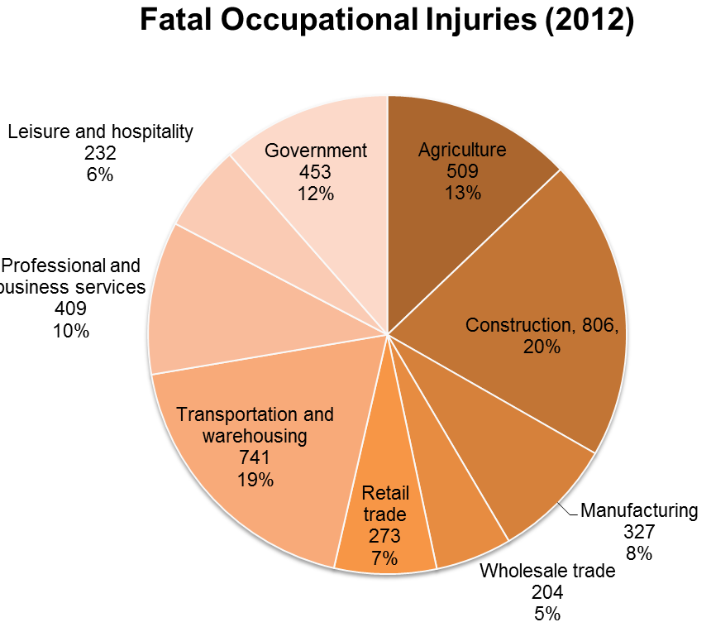
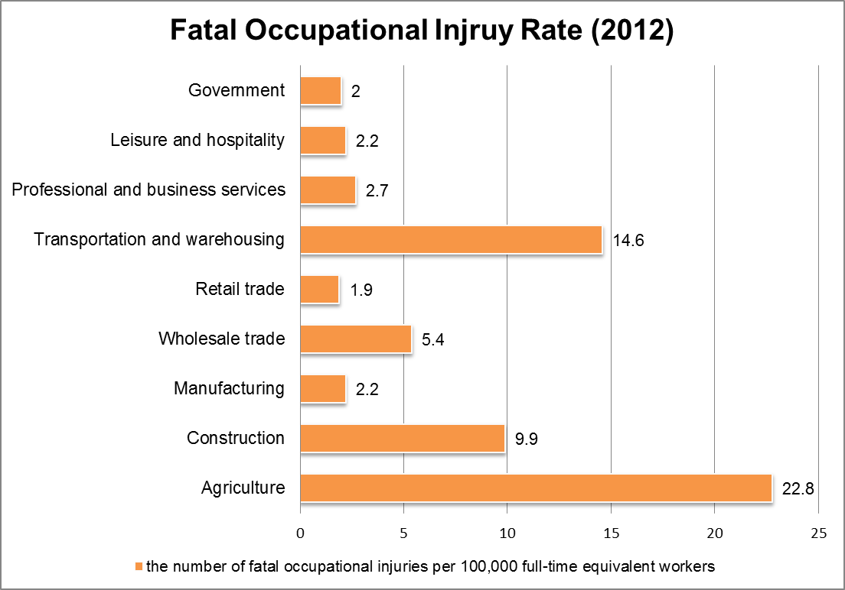
Safety in the Construction Industry
High Incidence Rate in the Construction Industry
Despite recent improvements in construction methods and technologies, the improvement of construction safety is not satisfactory.
[Adopted from U.S Bureau of Labor Statistics 2014]

Slide 4
Safety in the Construction Industry
Causes of Accident
Unsafe Behavior
Unsafe Work Conditions (10 – 20%)
Focus of most of previous efforts
Accidents
Unsafe Behaviors
(80 – 90%)
Recently attracted attentions
[Adopted from Lingard and Rowlinson 2005]
Error
• “Unintended outcomes caused by slips, lapses and mistakes made by individuals.” (Reason 1990)
Unsafe Behavior
• “Any deliberate or intentional deviations from the rules, procedures, instructions or regulations introduced for the safe or efficient operation and maintenance of equipment.” (Reason 1990)
• More than half of accidents recorded are attributed to violations (Mason, 1997; Alper and Karsh 2009)
Violation

Slide 5
Social Influence on Safety Behavior
Social influence on Individuals’ Behavior
Social comparison theory (Festinger 1954)
Individuals evaluate their opinion or ability by comparing themselves to others to reduce the uncertainty.
Social cognitive theory of self-regulatory (Bandura 1991)
When there is a discrepancy between one’s own reference value and perceived current situation, people perform the behavior to reduce the discrepancy
Social Influence on Safety Behavior
The group level informal controls (i.e., the safety norm, safety climate) have much to do with safety behavior.
A number of studies empirically supported that safety climate is an important determinant of actual safety behavior.
A lack of research addressing individual’s psychological process underlying the link between social influence and safety behavior

Slide 6
Point of Departure: Theory of Planned Behavior
Theory of Planned Behavior (Azjen 1991)
Attitude
A favorableness of evaluation or appraisal of the behavior in question.
Subjective Norm
The perceived social pressure from significant others to perform or not to perform a specific behavior
Perceived Behavioral Control
The perception of the ease or difficulty of performing the behavior of interest
Several limitations to direct application of TPB to safety behavior
Behavioral
Attitude
Subjective Norm
Behavioral
Intention
Behavior
Perceived
Behavioral
Control

Slide 7
Current Knowledge Gaps
A lack of understanding of the role of subjective norm in safety behavior
Controversy over influence of subjective norm on behavioral intention.
A lack of understanding of characteristics of construction workforce in social context
Multiple organizational hierarchy have presented a significant hurdle in studying the effect of social norms on safety behavior.
A lack of knowledge of the social mechanism of workers’ safety behavior
Cross sectional study or variable based approach → Difficult to uncover the underlying process of group behavior emerging from individuals’ interaction

Slide 8
Research Objectives and Approaches
To identify the effect of group norms and social identification on safety behavior
Approach: Survey and Statistical Analysis Techniques
To identify the individuals’ psychological process and social influence process on safety behavior
Approach: Survey and Structural Equation Model (SEM)
To create empirical-grounded computational rules to study complex and dynamic social influence processes regarding safety behavior
Approach: the empirically grounded Agent Based Modeling and Simulation (ABMS)

Slide 9
Outline
Introduction
Effect of Group Norms and Social Identification on Safety Behavior
Individuals’ Psychological Process and Social Influence on Safety Behavior
Modeling the Effect Social Influence on Safety Behavior
Acknowledgement

Slide 10
Social Identity as a Moderator of Social Influence
Social Identity Theory
Self-image derived from the social categories to which he/she perceives himself/herself as belonging (Tajfel and Turner 1979).
Effects of subjective norm depend on salience of social identity (Terry et al. 1999).
Social norms should have a significant effect particularly for those who identify strongly with the group (Ashforth and Mael 1989; Terry and Hogg 1996; Hogg and Terry 2000).
Complexity of Construction Workers’ Social Identities
Construction workers have multiple memberships in a project (e.g., crew, company, union, trade, project, etc.).
Itinerant and temporary nature of construction projects and on-site work group.

Slide 11
Research Overview
Research Goals
To enhance our understanding of how and what creates construction workers’ safety behaviors.
Research Objectives
To identify current status of construction workers’ social identities.
To understand the effect of group norms on workers’ safety behaviors.
To identify impact of construction workers’ social identification on the social influence.
Hypotheses
There are significant differences across the construction workers’ levels of social identification with each group.
There is no significant correlation between workers’ working duration in a project and level of social identification with project.
Managers desired norm will be more strict than workers’ personal standard.
There is a significant correlation between construction workers’ personal standard and their perceived group norms (Social Influence).
There is a significant correlation between workers’ level of social identification and strength of social influence (Social Identity Influence).

Slide 12
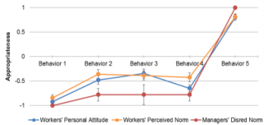
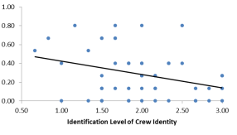
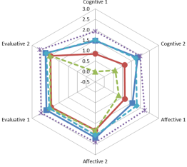
Research Design
Correlation Analysis
Perceived
Group
Norm
2) Social Influence
Personal
Standard
Safety
Behavior
Correlation Analysis
3) Social
Identity Effect
Social
Identity
; Measured by Survey Questionnaire
; Measured by Norm Elicitation Protocol
Paired t test

Slide 13
Social Identity Survey
Dimension of Social Identity
Social identity consists of cognitive, affective, and evaluative components (Ellemers et al. 1999; Bergami and Bagozzi 2000; Jackson 2002; Heere and James 2007).
Cognitive dimension
A cognitive awareness of one’s membership in a social group (e.g., “I am a member of Group X.”)
Affective dimension
A sense of emotional involvement with the group (e.g., “ I am happy to be a member of Group X.”)
Evaluative dimension
A positive or negative value connotation attached to the group memberships (e.g., “I am proud of being a member of Group X”)

Slide 14
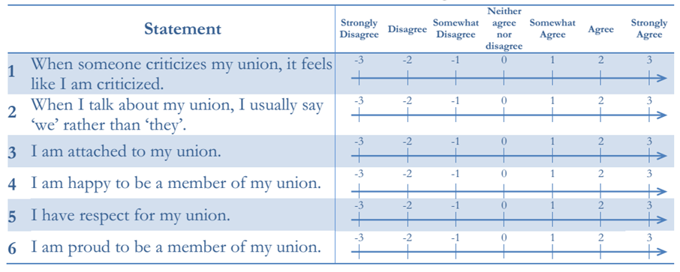
Social Identity Survey
Survey Items for Social Identity Measurement
Six verbal items (two items for each dimension) from the social identity literatures (on 7-point Likert scale).
Participants are asked about their feeling toward each group at the construction site (crew, company, trade, union, and project)
Cognitive
Dimension
Affective
Dimension
Evaluative
Dimension

Slide 15
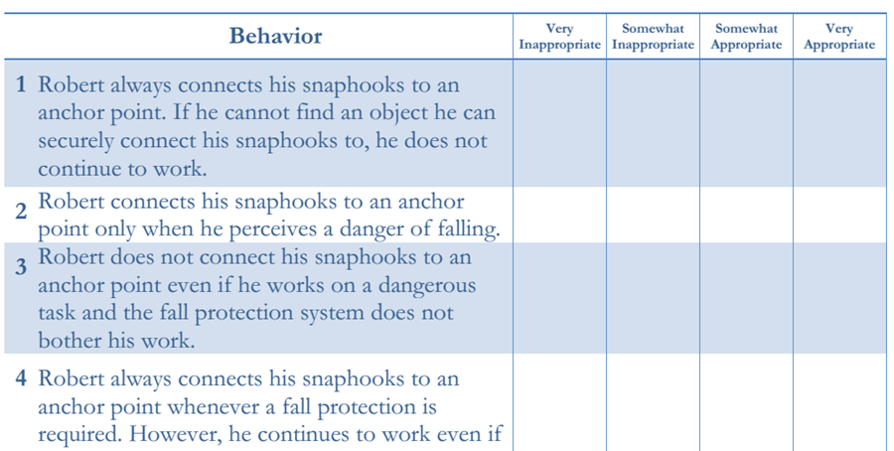
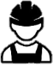
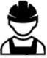




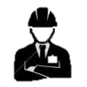

Perceived Group Norm and Personal Standard
Norm Elicitation Protocol (Burks and Krupka 2012)
After reading the hypothetical vignette, subjects are asked to evaluate a range of actions.
①
Workers
①
Crew Members
②
②
Managers
①: Workers’ Perceived Group Norm
②: Workers’ Personal Standard
①: Managers’ Belief on Workers’ Behavior
②: Managers’ Desired Norm

Slide 16

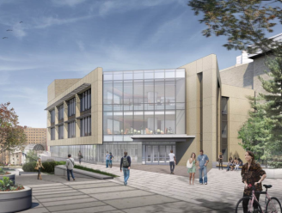

Data Collection
Sample
Site A
A large-sized university research facility building construction project in the University of Michigan campus
26 workers and 3 managers participated in the survey
Site B
A large-sized university library building renovation project in the University of Michigan campus
45 workers and 3 managers participated in the survey
Site C
A large-sized university research facility renovation project in the University of Michigan campus
35 workers and 3managers participated in the survey
[source: http://www.umaec.umich.edu/projects/major-projects]

Slide 17
Data Pre-Processing
Data filtering
Exclude responses from the one man crew
Site A – 4 participants, Site B – 2 participants, Site C – 4 participants
Exclude missing data (partial non-response)
Site A – 1 participant, Site B - 10 participants, Site C – 3 participants
Total responses
Site A: 21 responses (workers) + 3 responses (mangers)
Site B: 33 responses (workers) + 3 responses (mangers)
Site C: 28 responses (workers) + 3 responses (mangers)
Total: 82 responses + 9 responses (mangers)

Slide 18
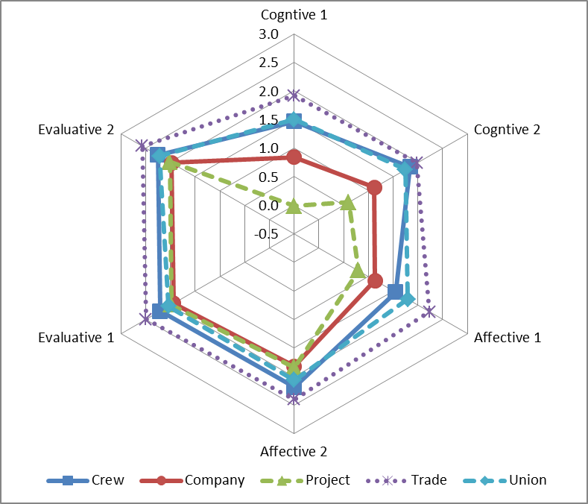
Level of Social Identification (Overall)
What is the level of workers’ social identification with each group in their jobsite?
Saliency
Project
Company
Union
Crew
Trade

Slide 19
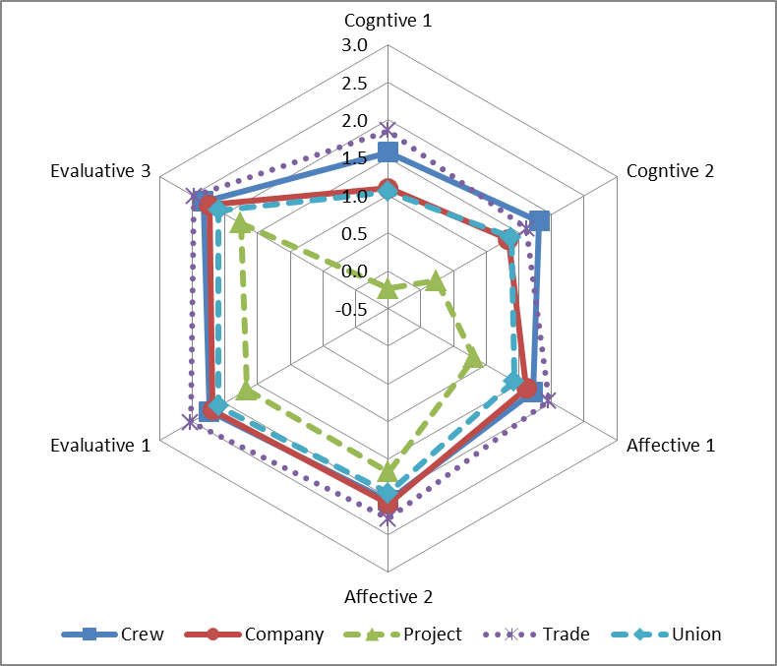
Level of Social Identification (Site A)
What is the level of workers’ social identification with each group in their jobsite?
Saliency
Project
Union
Company
Crew
Trade

Slide 20
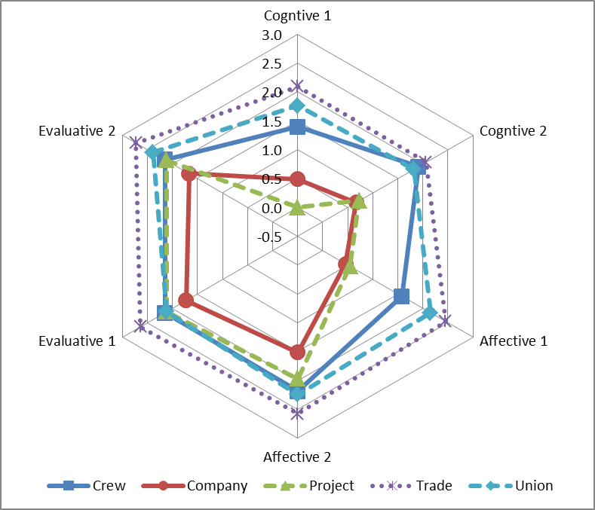
Level of Social Identification (Site B)
What is the level of workers’ social identification with each group in their jobsite?
Saliency
Company
Project
Crew
Union
Trade

Slide 21
Level of Social Identification (Site C)
What is the level of workers’ social identification with each group in their jobsite?
Saliency
Project
Company
Union
Crew
Trade

Slide 22
Effect of Work Duration on Social Identification
Is there any correlation between working duration and the workers’ social identification level with project or crew?
No Significant Correlation!
Additional actions will be required for improving social identity

Slide 23
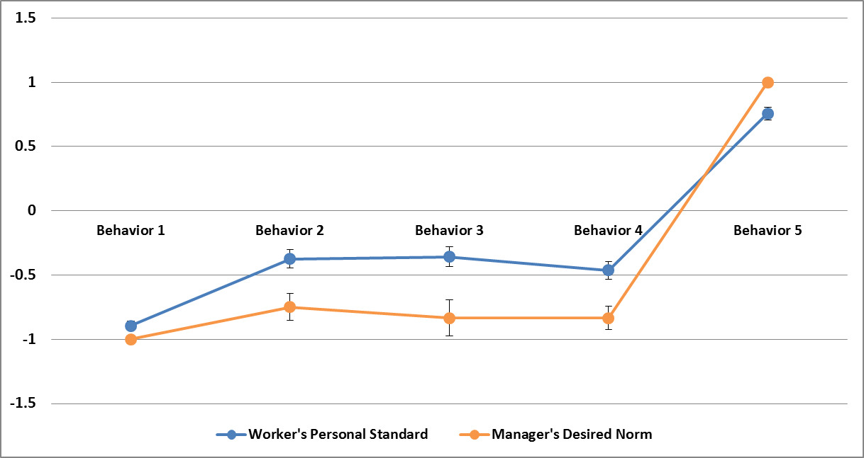
Managers’ Desire and Workers’ Personal Standard
Is there any differences between workers’ personal standard and mangers’ desired norm?
Independent Sample T test

Slide 24
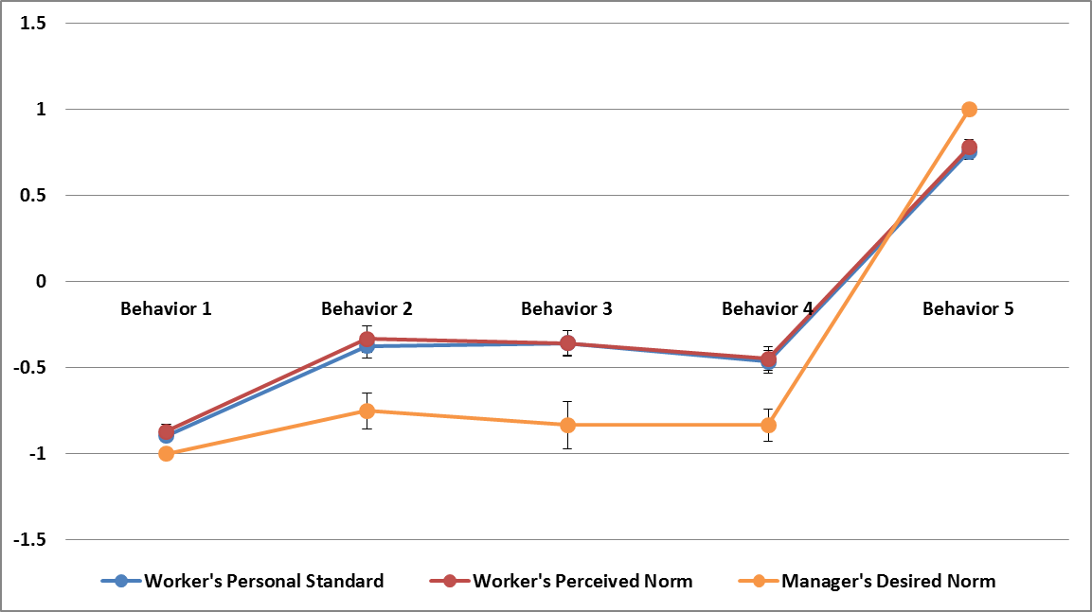
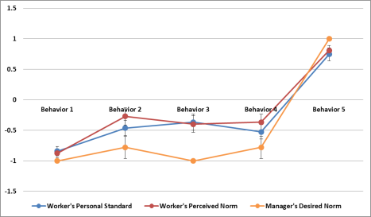
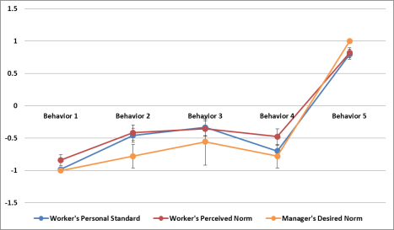
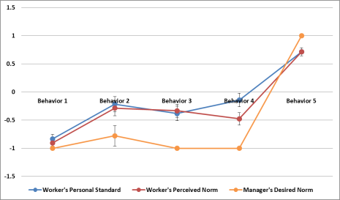
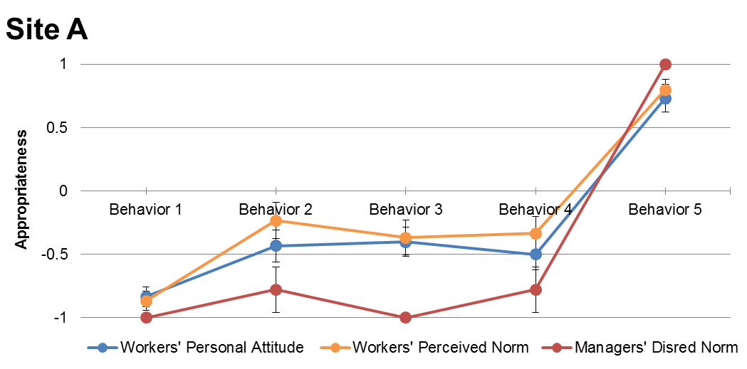
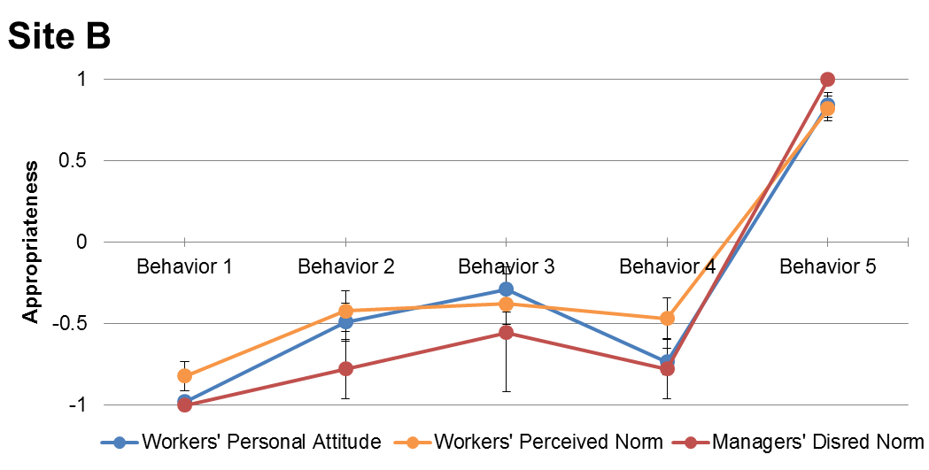
Social Influence
Is there any correlation between workers’ personal standard and their perceived norm?
Overall
Site A
Site B
Site C
Figure 6: Correlation between perceived norm and personal attitude (Site A)
Figure 7: Correlation between perceived norm and personal attitude (Site B)

Slide 25
Social Identification Effect
Measurement

Slide 26
Conclusions
Current Status of Social Identity
Construction workers identity themselves most saliently with their trade and least saliently with their project.
The detailed order of social identification level varies with different project situation.
Workers’ working duration does not affect the their level of social identification with their crew and project.
Social Influence and Social Identification Effect
Construction workers’ personal standard is influenced by their perceived group norms toward the safety behavior.
Workers who show higher level of identification with the crew have personal standard more aligned with the perceived crew’s norm.

Slide 27
Outline
Introduction
Effect of Group Norms and Social Identification on Safety Behavior
Individuals’ Psychological Process and Social Influence on Safety Behavior
Modeling the Effect Social Influence on Safety Behavior
Acknowledgement

Slide 28
Background
Limited Consideration of Types of Social Norms in TPB
Injunctive social norms
Perception of which behaviors are approved or disapproved by others
Descriptive social norms
Perception of which behaviors are typically performed by others
Subjective norms in TPB reflect only social injunctive norm
Different Sources of Social Norms in Construction
Observation of coworkers’ behavior
Descriptive norm
Feedback from project managers (e.g., safety manager, superintendents)
Workers perceive an acceptable level of unsafe behavior by observing managers’ feedback on their particular behavior
Injunctive norm

Slide 29
Background
Structural Equation Model (SEM)
A multivariate analysis method for interrelated dependent relationship simultaneously (Hair et al. 2006).
Produce a more accurate representation of result than traditional statistical methods (e.g., multiple regression, ANOVA, correlation analysis) because it accounts for types of errors in the variables.
Research Objectives
To identify individual’s psychological process and social influence on workers’ safety behavior
Effect of different social norms (e.g., workgroup norm, management norm) on workers’ safety behavior.
Effect of different social identities (e.g., crew, project) on social influence process regarding safety behavior.

Slide 30
Conceptual Model
Individuals’ Psychological Process Regarding Safety Behavior
Extended Theory of Planned Behavior
Workgroup – Level
Perceived
Workgroup
Norm
Shared
Behavior
Crew
Based
Identity
Individual – Level
Attitude
toward
Behavior
Behavioral
Intention
Safety
Behavior
Project – Level
Project
Based
Identity
Manager’s
Desired
Norm
Perceived
Management
Norm
Task – Level
Perceived
Behavioral
Control
Communication

Slide 31
Outline
Introduction
Effect of Group Norms and Social Identification on Safety Behavior
Individuals’ Psychological Process and Social Influence on Safety Behavior
Modeling the Effect Social Influence on Safety Behavior
Acknowledgement

Slide 32
Background
Modeling Human Behavior in Organization
Variable based model
“Covering law” or “statistical regularity”: Cross sectional survey
Difficult to uncover the specific process that account for observed behavior
Difficult to investigate effect of possible managerial actions to change the members behavior
Mechanism-oriented approach
Explain an observed phenomena by postulating a process of interaction among individuals.
Provide more deeper understanding of the phenomena that statistical explanations (Smith and Conrey 2007)
Complementarity between variable based model and mechanism–oriented approach

Slide 33
Background
Agent-Based Modeling and Simulation (ABMS)
Enables us to observe the organizational phenomena emerging from individuals’ interaction.
Behaviors and interactions are represented by behavioral rule in ABMS.
The modeler can observe the agents’ behavior at the individual level and group level by running simulation.
Research Objectives
To create a computational rules to study complex and dynamic social influence process regarding safety behavior
To explore emergent of group-level phenomena about safety behavior in construction
To identify feasible management policies/actions that can influence social context and improve safety behavior.

Slide 34
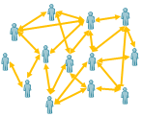
Conceptual Model
Complex and Dynamic Social Influence Process Regarding Safety Behavior
Computational modeling of workers social identifications and safety behaviors.
Individual Level
Group Level
Perceived
Workgroup
Norm
Observation and Perception
Crew
Based
Identity
Attitude
Toward
Behavior
Behavioral
Intention
Behavior
Taking
Safety
Behavior
Interaction
Aggregated
Safety
Behavior
Intention
Formation
Project
Based
Identity
Perceived
Behavioral
Control
Perceived
Project
Norm
Communication
Manager’s
Desired
Norm

Slide 35
Outline
Introduction
Effect of Group Norms and Social Identification on Safety Behavior
Individuals’ Psychological Process and Social Influence on Safety Behavior
Modeling the Effect Social Influence on Safety Behavior
Acknowledgement

Slide 36




Acknowledgement
National Science Foundation (GRANT #: SES-1127570)
Industry Partners
Collaborator
Dr. Seungjun Ahn
Post-Doctoral Research Fellow, Dept. of Civil and Environmental Engineering, University of Alberta

Slide 37
References
Ajzen, I. (1991). "The theory of planned behavior." Organizational Behavior and Human Decision Processes, 50(2), 179-211.
Ashforth, B. E. and Mael, F. (1989). "Social Identity Theory and the Organization." Academy of Management Review, 14(1), 20-39.
Bandura, A. (1991). "Social cognitive theory of self-regulation." Organizational Behavior and Human Decision Processes, 50(2), 248-287.
Bagozzi, R. and Yi, Y. (2012). "Specification, evaluation, and interpretation of structural equation models." Journal of the Academy of Marketing Science, 40(1), 8-34.
Bergami, M. and Bagozzi, R. P. (2000). "Self-categorization, affective commitment and group self-esteem as distinct aspects of social identity in the organization." British Journal of Social Psychology, 39(4), 555-577.
BLS (2014). Revisions to the 2012 Census of Fatal Occupational Injuries (CFOI) counts. U.S. Bureau of Labor and Statistics.
Burks, S. V. and Krupka, E. L. (2012). "A Multimethod approach to identifying norms and normative expectations within a corporate hierarchy: Evidence from the financial services industry." Management Science, 58(1), 203-217.
Ellemers, N., Kortekaas, P. and Ouwerkerk, J. W. (1999). "Self-categorisation, commitment to the group and group self-esteem as related but distinct aspects of social identity." European journal of social psychology, 29(23), 371-389.
Festinger, L. (1954). "A theory of social comparison processes." Human relations, 7(2), 117-140.
Hair, J. F., Tatham, R. L., Anderson, R. E. and Black, W. (2006). Multivariate data analysis, Pearson Prentice Hall Upper Saddle River, NJ.
Heere, B. and James, J. D. (2007). "Stepping Outside the Lines: Developing a Multi-dimensional Team Identity Scale Based on Social Identity Theory." Sport Management Review, 10(1), 65-91.
Hogg, M. A. and Terry, D. I. (2000). "Social identity and self-categorization processes in organizational contexts." Academy of management review, 25(1), 121-140.
Jackson, J. W. (2002). "Intergroup attitudes as a function of different dimensions of group identification and perceived intergroup conflict." Self and identity, 1(1), 11-33.

Slide 38
References
Lingard, H. and Rowlinson, S. M. (2005). Occupational health and safety in construction project management, Taylor & Francis.
Reason, J. 1990. Human error. 1990. Cambridge, UK: Cambridge University Press.
Smith, E. R. and Conrey, F. R. (2007). "Agent-based modeling: A new approach for theory building in social psychology." Personality and social psychology review, 11(1), 87-104.
Tajfel, H. and Turner, J. C. (1979). "An integrative theory of intergroup conflict." The social psychology of intergroup relations, 33(47), 74.
Terry, D. J. and Hogg, M. A. (1996). "Group Norms and the Attitude-Behavior Relationship: A Role for Group Identification." Personality and Social Psychology Bulletin, 22(8), 776-793.
White, K. M., Smith, J. R., Terry, D. J., Greenslade, J. H. and Mckimmie, B. M. (2009). "Social influence in the theory of planned behaviour: The role of descriptive, injunctive, and in-group norms." British Journal of Social Psychology, 48(1), 135-158.

